Slide 1

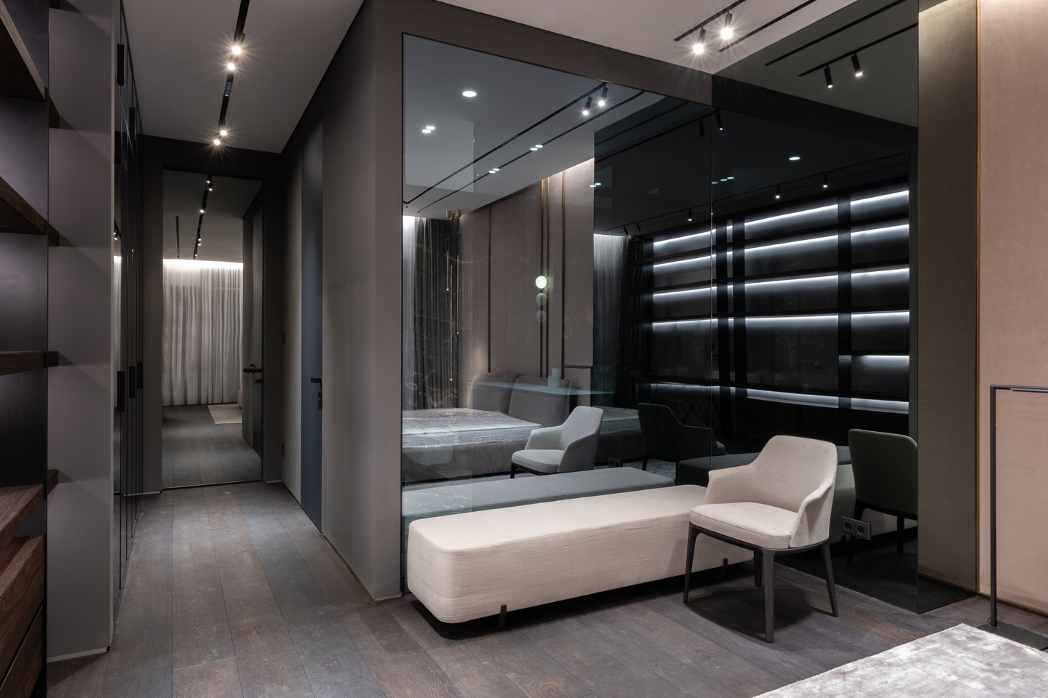
MJ
Page 01
FURNITURE SALES ANALYSIS DASHBOARD – EXCEL PROJECT
Data-Driven Insights from Retail Sales Using Excel Tools
Presented by Mirtunjay kumar
Getting Started

Slide 2
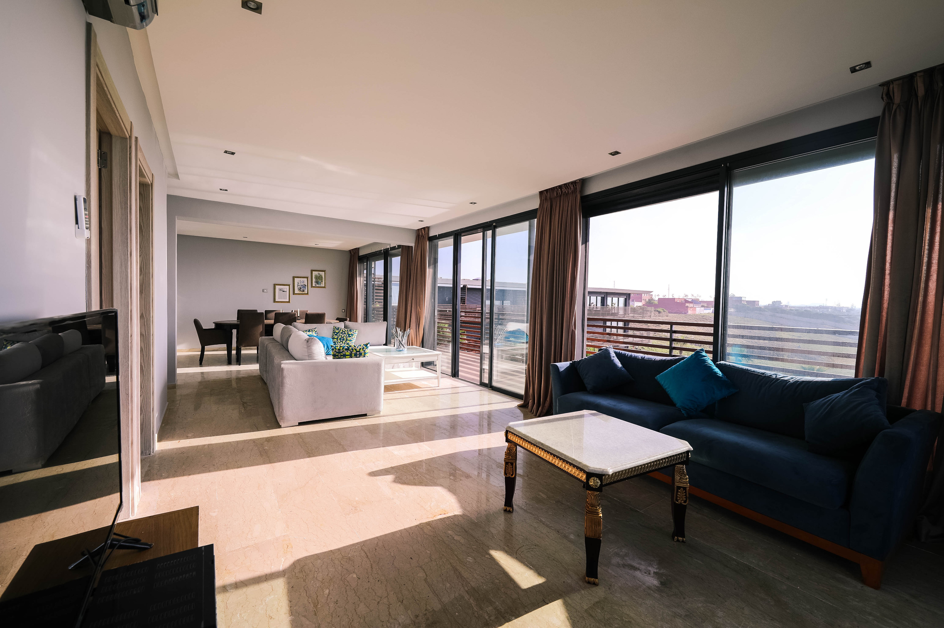

PROJECT OVERVIEW
MJ
Page 02
Project Objective and scope
Analyses Sale Data to Uncover Business Insight , Trends and Visualize Key Performance metrics using Excel Dashboarding Techniques .
The objective of this project is to design a dynamic Excel dashboard that provides actionable insights from furniture sales data. The scope includes cleaning and organizing raw data, calculating key performance metrics such as total sales, number of orders, and average order value, and analyzing trends by product category, region, and customer segments. This project also focuses on identifying top-performing products and customers, visualizing monthly sales trends, and presenting findings through an interactive, easy-to-use dashboard to support informed business decisions

Slide 3

MJ
Page 03
Tools & Techniques
This project was executed using Microsoft Excel, leveraging a range of advanced features and functions. PivotTables and Pivot Charts were used to summarize and visualize data effectively, while formulas such as SUMIFS, IF, and VLOOKUP were applied for calculated fields and custom metrics. Slicers were incorporated to enhance interactivity and allow dynamic filtering across the dashboard. Additionally, data cleaning techniques were used to structure and prepare the dataset, and conditional formatting was applied to highlight key insights, making the final dashboard both informative and user-friendly

Slide 4
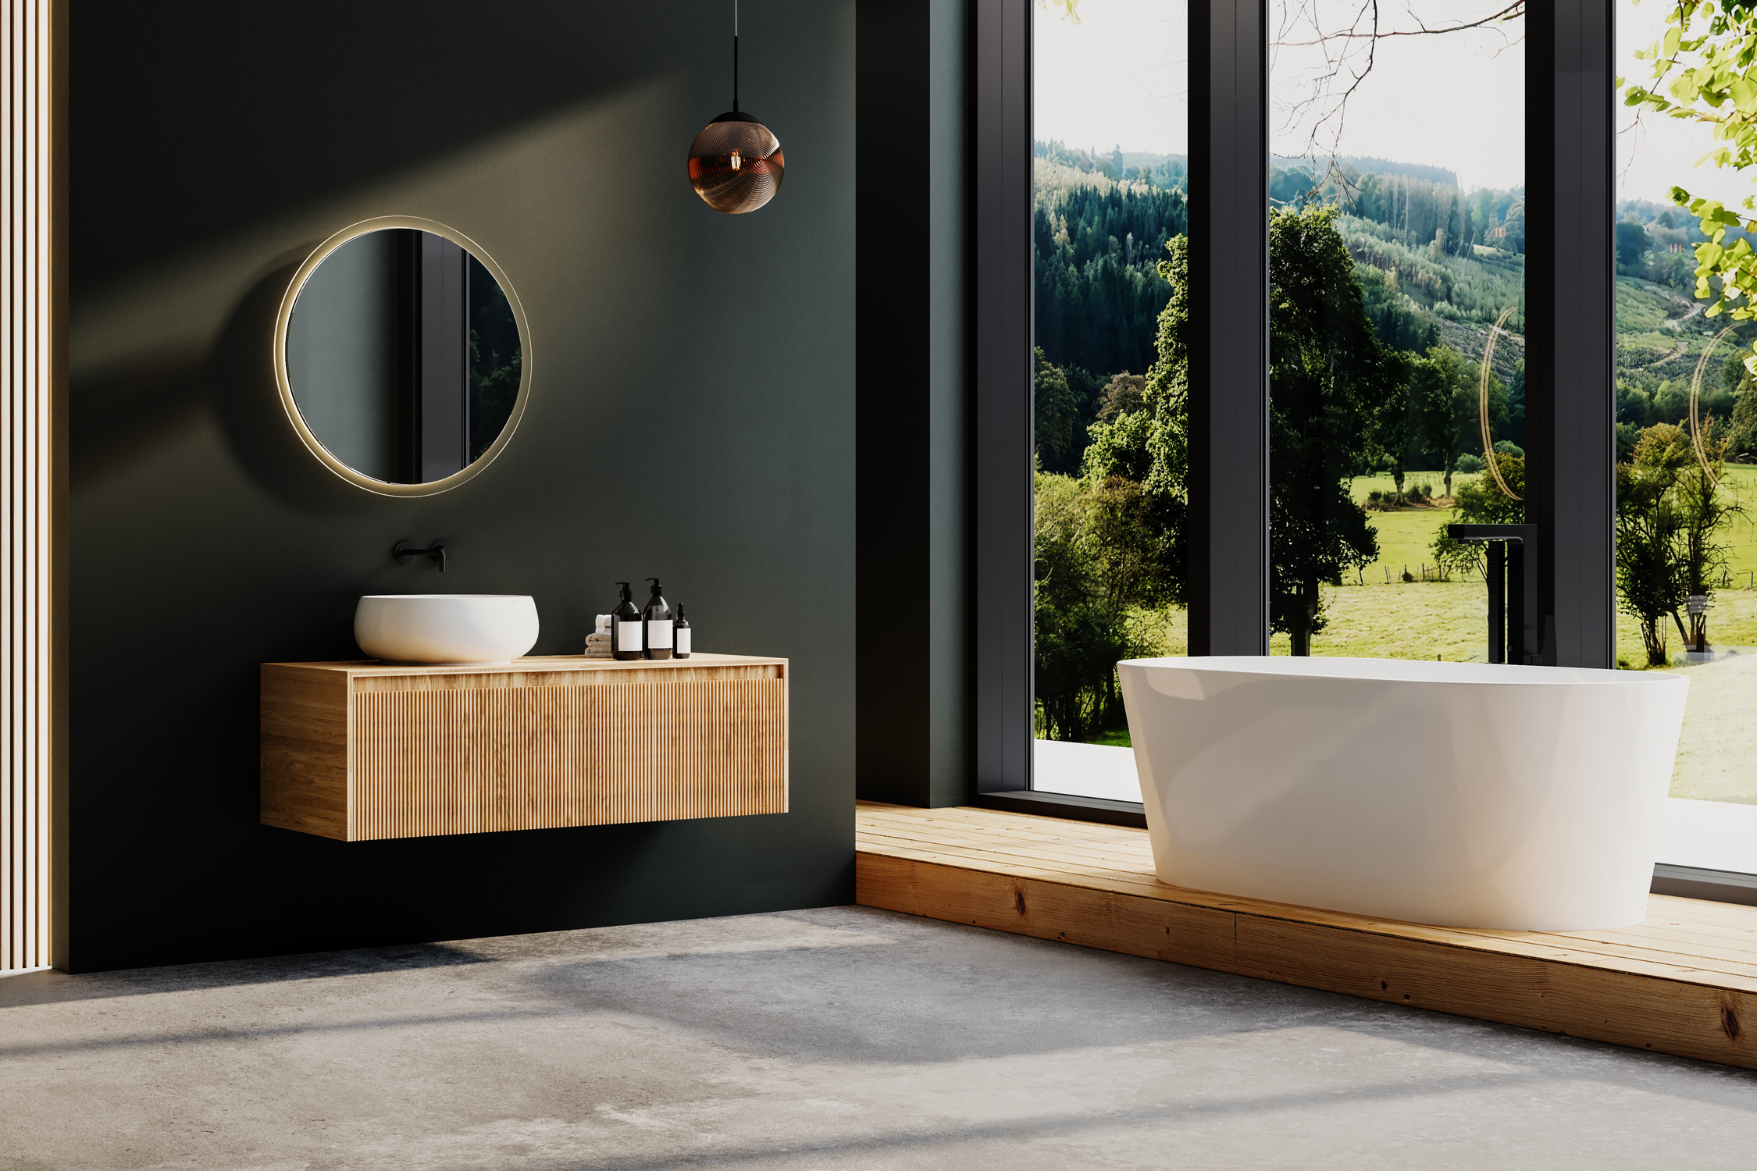

MJ
Page 04
Executive Summary
The furniture sales dashboard provides a high-level overview of key business metrics, enabling quick and effective decision-making. It highlights total sales revenue, number of orders, and average order value, offering a snapshot of overall performance. The dashboard further breaks down sales by product category, region, and customer, allowing stakeholders to identify top contributors and underperforming areas. Monthly sales trends are visualized to reveal seasonality or growth patterns. With interactive slicers and clean visuals, this executive summary serves as a central tool for monitoring business health and driving data-informed strategies.

Slide 5
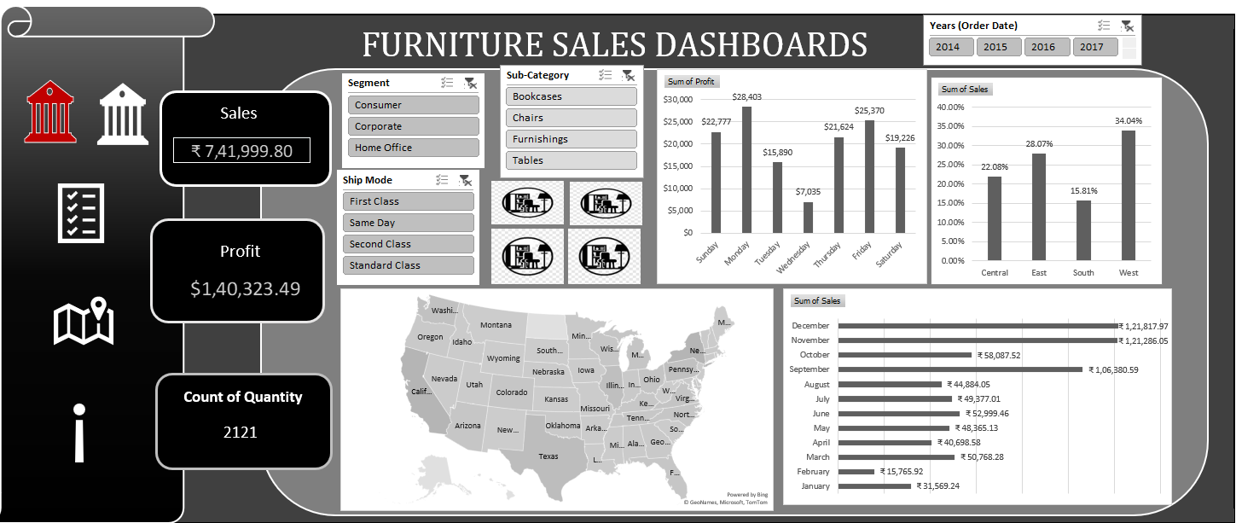
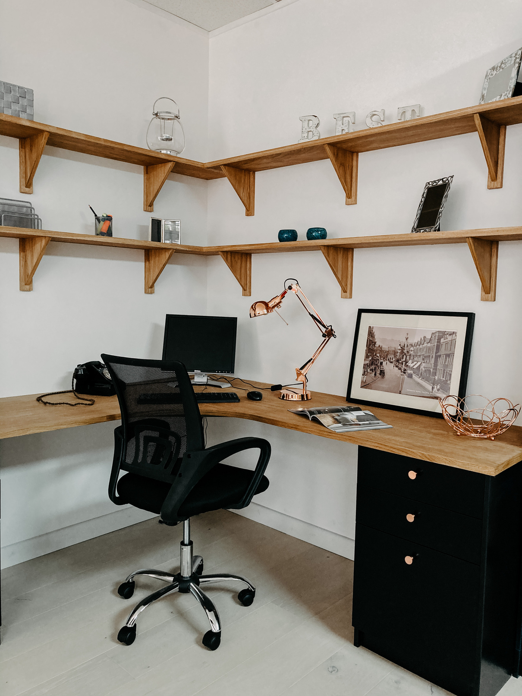


MJ
Page 05
FURNITURE FOR WORK
Furniture in commercial spaces is more than just functional, it shapes how teams collaborate, focus and innovate.

Slide 6
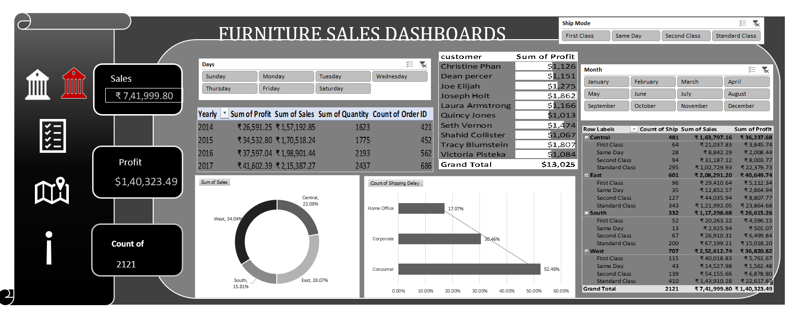
MJ
Page 06
FURNITURE FOR WORK
Furniture in commercial spaces is more than just functional, it shapes how teams collaborate, focus and innovate.

Slide 7


MJ
Page 07
Key Insight & Business impact
The analysis revealed that a few key product categories contribute the majority of sales, highlighting opportunities to focus inventory and promotions on high-performing items. Certain regions consistently outperformed others, suggesting potential for geographic expansion or targeted marketing. Top customers showed significantly higher average order values, indicating the value of personalized engagement strategies. Monthly trends exposed seasonal peaks, helping in forecasting and inventory planning.
These insights empower the business to streamline operations, improve customer targeting, optimize product mix, and ultimately drive revenue growth through informed, data-backed decisions.

Slide 8


MJ
Page 08
Conclusion & Recommendations
The furniture sales dashboard effectively transformed raw sales data into meaningful insights, enabling clear visibility into performance drivers across products, regions, and customers. The interactive visuals and KPI tracking support faster, more informed decision-making.
Recommendations:
Focus marketing on high-performing categories and regions.
Strengthen relationships with top customers to increase retention and sales.
Use monthly trend data for better inventory planning and seasonal campaigns.
Expand dashboard use across teams for cross-functional insights.

Slide 9
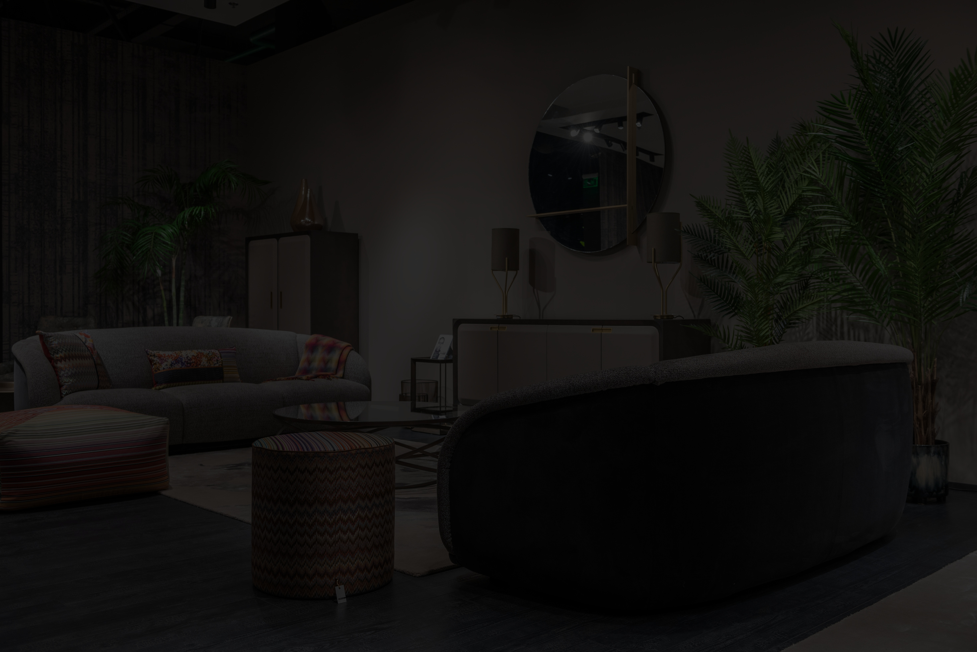




MJ
Page 09
7979982592
THANK YOU FOR YOUR TIME!
https://github.com/Mirtunjay24
MIRTUN1999@GMAIL.COM
https://www.linkedin.com/in/mirtunjay-kumar23/
Thank you for exploring the world of innovative and sustainable furniture design with us. Get in touch, and let’s turn your vision into reality.
Let's Create Something Extraordinary Together
Presented by MIRTUNJAY KUMAR

